Slide 1
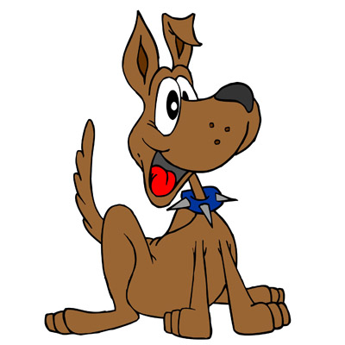
Hund (m)

Slide 2
Kaninchen (n)

Slide 3
Katzen (pl)

Slide 4
Fisch (m)

Slide 5
Pferd (n)

Slide 6
Maus (f)

Slide 7
my

Slide 8
your

Slide 9
his

Slide 10
his

Slide 11
her

Slide 12
her

